Slide 1
Pester Tour
Windows Boston User Group
WindowsBoston.org
By Gene Laisne

Slide 2
What’s Pester?
Pester is a PowerShell module used for Test Drive Development
Test Driven Development
Write the test first, then the code
Example:
I want to write a function that adds two numbers
If I give my function the number 5 & the number 10 it should come up with 15.
Write the test…
Write the code…
Run the test against the code, giving the function 5 & 10.
The function passes.
What if I give my function the number 5 and the string 10? I want my code to throw an error.
Write the test…
Write the code…
Test the code…
In this way, the pester test becomes the benchmark for you code.

Slide 3
Simple Example
https://github.com/pester/Pester/tree/master/Examples/Calculator

Slide 4
Building Blocks
Describe
Keyword
Logical grouping of tests
Topmost grouping in a script
A script can have one or more Describe blocks
Context
Keyword
Logical grouping of tests
A Describe block can have zero or more Context blocks
A Describe block with no Context blocks runs a single context.

Slide 5
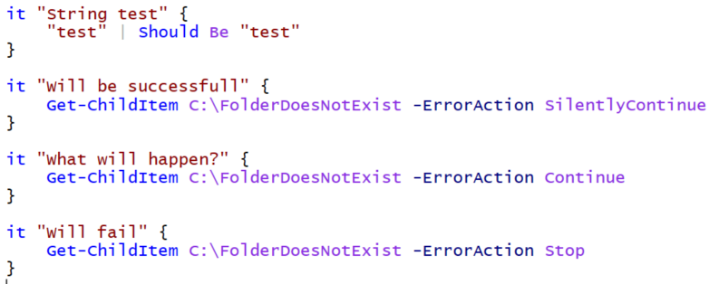
Tests
It
Keyword
Defines a single test
May not end with an Assertion, but whatever is run within the it block will need to throw an error if it fails.

Slide 6
Should…
Keyword
Asserts the statement is correct. If it isn’t, then it throws an exception.
Usage:
Should <Operator> <What is being tested>
Examples:
(Demo: ShouldExamples.ps1)

Slide 7
Can Pester test my system?
Yes.
Pester is a framework for tests. Why not test your system.
Pester users Assertions to prove if things are what they “Should Be”
Think about your systems.
The IP “Should Be” x.x.x.x
The DNS “Should Be” y.y.y.y
The BlahBlah service “Should Be” “Running”
It should/shouldn’t be able to reach the Internet
It should be able to reach the DB…
All of these things are accessable with PowerShell and therefor testable with Pester.

Slide 8
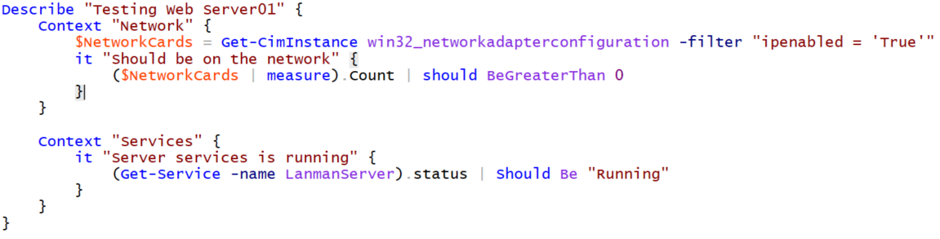
Example

Slide 9
Operation Validation Framework
http://www.GitHub.com/PowerShell/Operation-Validation-Framework
PowerShell module written by Microsoft built to organize and execute Pester tests which are written to validate operation.
Great overview of turning Pester tests into modules with Operational Validation Framework https://dscottraynsford.wordpress.com/2016/10/23/continuously-testing-your-infrastructure-with-ovf-and-microsoft-operations-management-suite/

